Slide 1
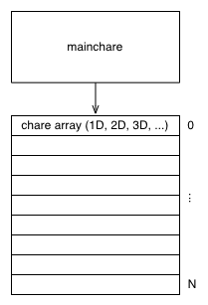
Charm++ Objects
A “chare” is a C++ object with methods that can be remotely invoked
The “mainchare” is the chare where the execution starts in the program
A “chare array” is a collection of chares of the same type
Typically the mainchare will spawn a chare array of workers

Slide 2
Charm++ File Structure
The C++ objects (whether they are chares or not)
Reside in regular .h and .cpp files
Chare objects, messages, message coordination, and entry methods (methods that can be called asynchronously and remotely)
Are defined in a .ci (Charm interface) file
And are implemented in the .cpp file

Slide 3
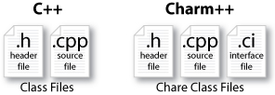
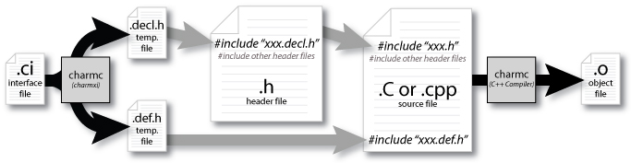
Charm++ File Structure

Slide 4
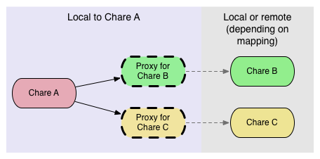
Charm++ Proxy Objects
Proxy objects are handles for invoking entry methods on other chares
These chares may be local or remote depending on the mapping

Slide 5
Charm++ Hello World
Hello world program asynchronous flow
Mainchare sends message to Hello object
Hello object prints “Hello World!”
Hello object sends message back to the mainchare
Mainchare quits the application

Slide 6
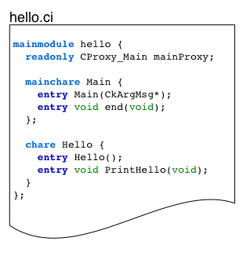
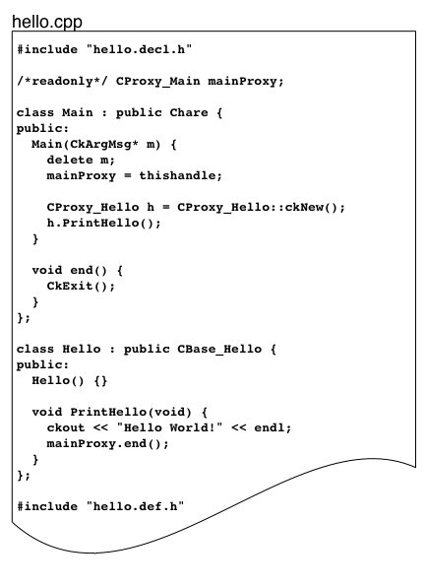
Charm++ Hello World

Slide 7
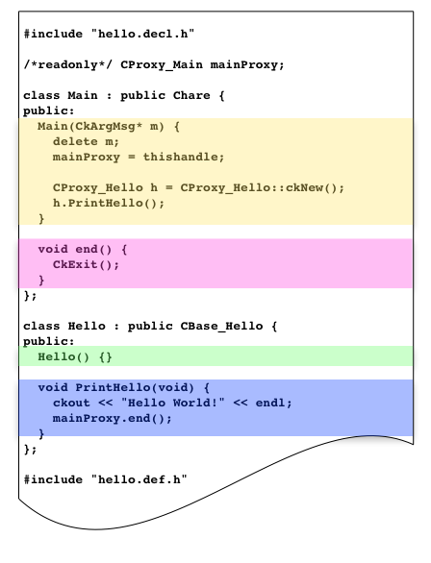
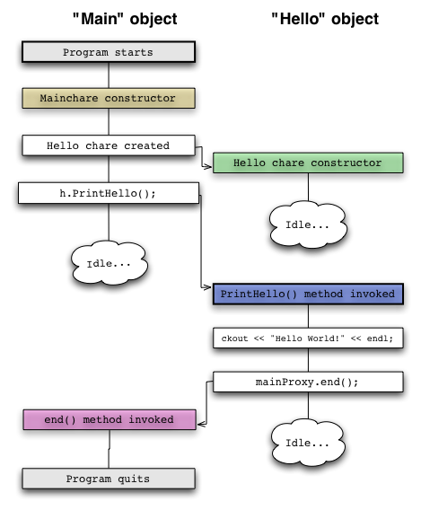
Charm++ Hello World

Slide 8
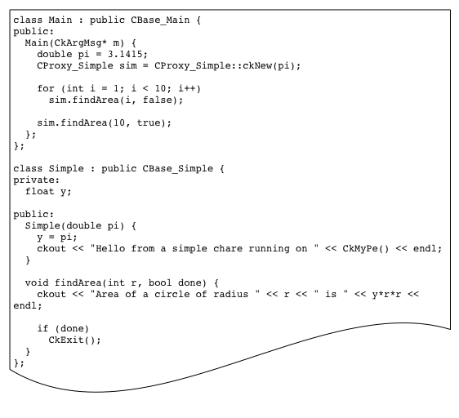
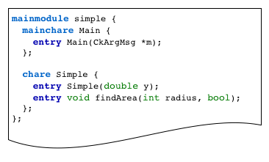
Charm++ Asynchronous Methods
Does this code produce the desired output?

Slide 9
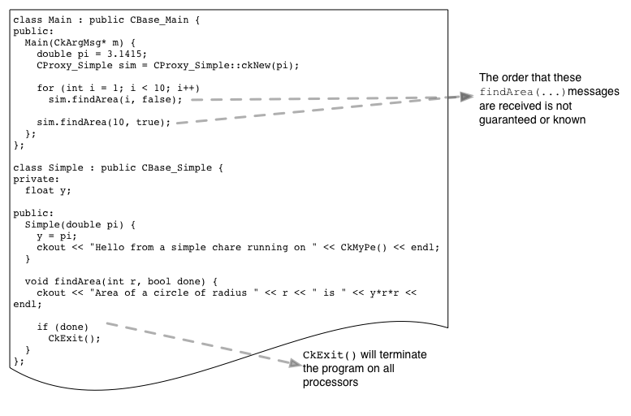
Charm++ Asynchronous Methods
Maybe, however the program might terminate after printing some number of messages, because the order is unknown
This is probably not the desired output

Slide 10
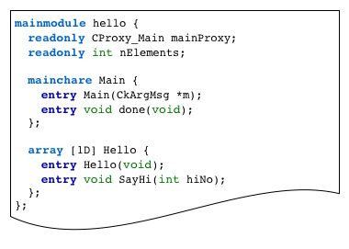
Charm++ Chare Arrays

Slide 11
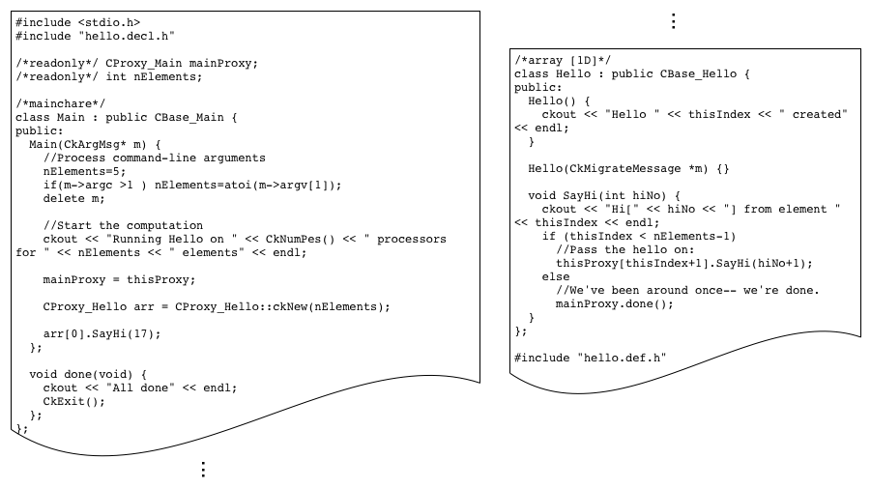
Charm++ Chare Arrays

Slide 12
Charm++ Van der Waals Example
Basic Idea
2D Van der Waals simulation
2D world broken into Cells
Each Cell is a chare, which will be mapped to a processor
Each Cell has a collection of particles
Each Cell communicates with its neighbors to compute particle interactions and update its particles
World is wrapped around

Slide 13
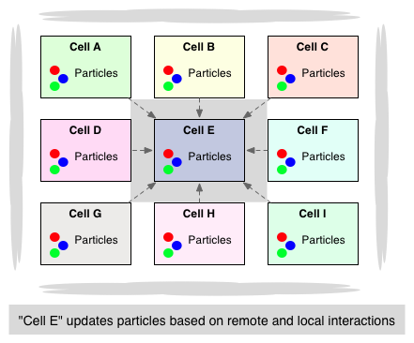
Charm++ Van der Waals Example

Slide 14
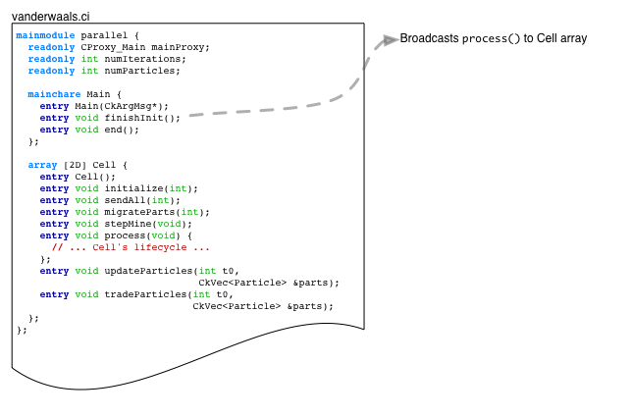
Charm++ Van der Waals Example

Slide 15
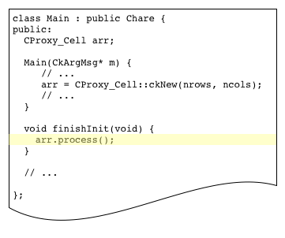
Charm++ Broadcasts
“arr” is a 2D chare array
Broadcasts are a simple way to invoke the same method on every element of the array

Slide 16
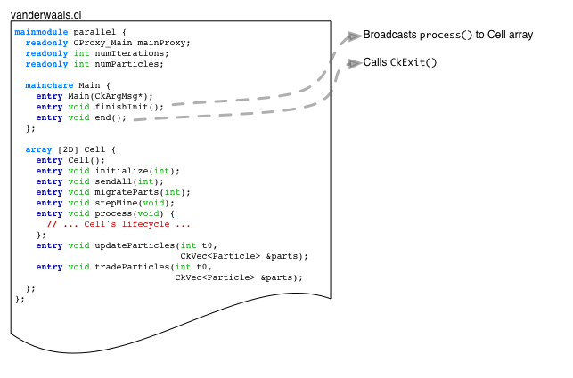
Charm++ Van der Waals Example

Slide 17
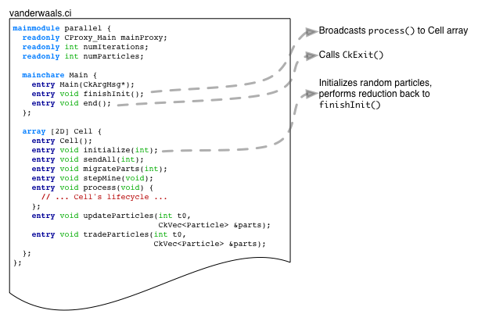
Charm++ Van der Waals Example

Slide 18
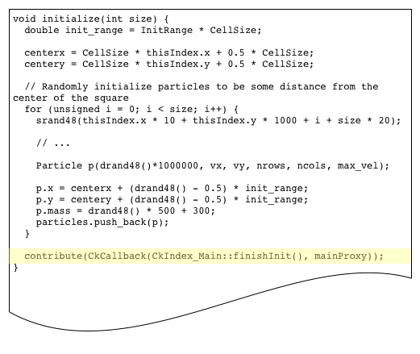
initialize() Method
The next step should not proceed until all the chares in the array have finished initialization

Slide 19
Charm++ Reductions
No global flow of control, so each chare must contribute with the contribute() function
A user callback (created using CkCallBack) is invoked when the reduction is complete

Slide 20
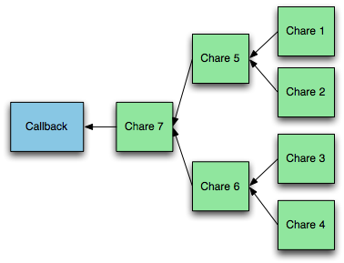
Charm++ Reductions
Runtime system builds a reduction tree
User specifies the reduction operation
At the root of the tree, a callback is performed on a specified chare

Slide 21
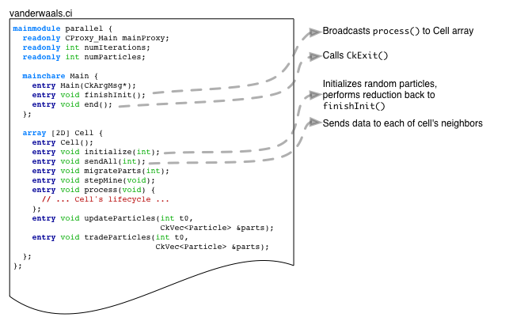
Charm++ Van der Waals Example

Slide 22
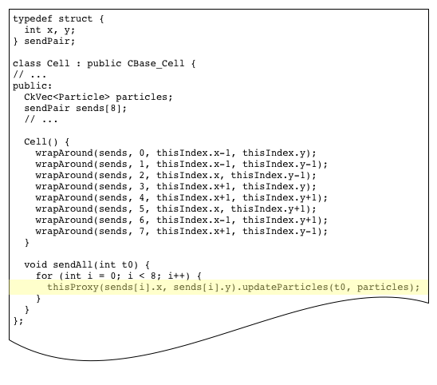
Sending the Particles
Point-to-point messages between chare array elements

Slide 23
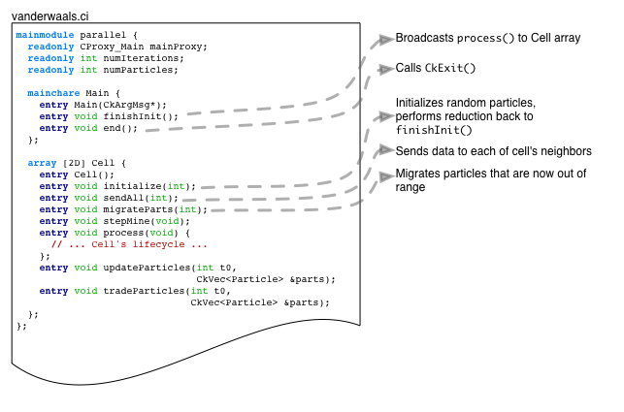
Charm++ Van der Waals Example

Slide 24
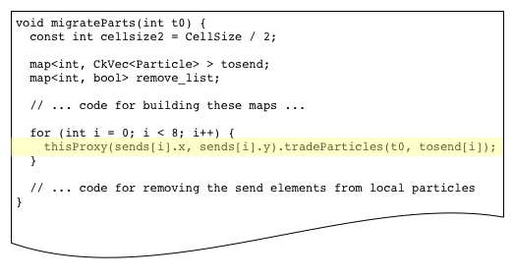
migrateParts() Method

Slide 25
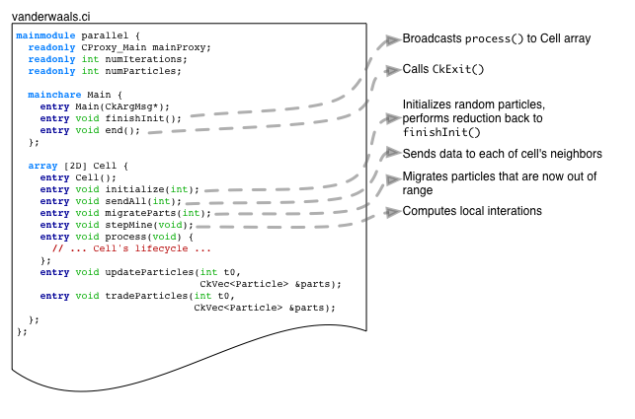
Charm++ Van der Waals Example

Slide 26
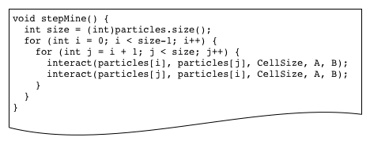
stepMine() Method

Slide 27
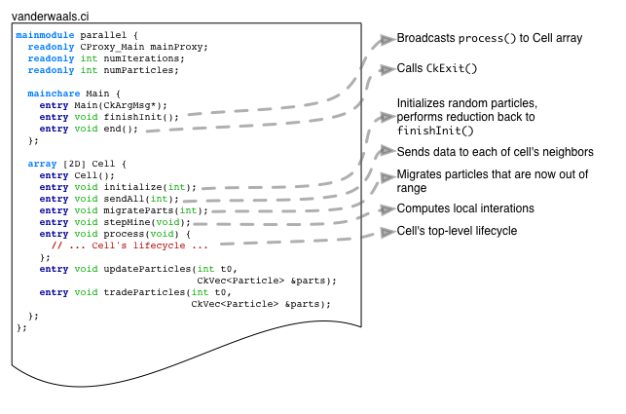
Charm++ Van der Waals Example

Slide 28
High Level Coordination in Charm++
Phil Miller

Slide 29
Charm++ Asynchronous Methods
Does this code produce the desired output?

Slide 30
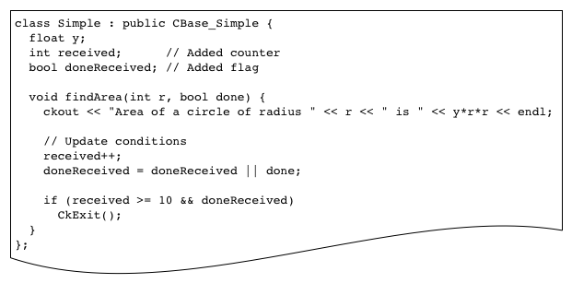
Counting Messages

Slide 31
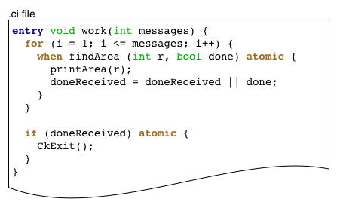
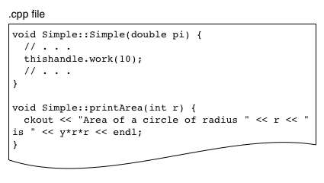
Counting with Coordination

Slide 32
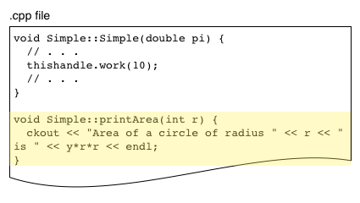
Counting with Coordination

Slide 33
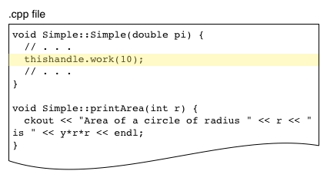
Counting with Coordination

Slide 34
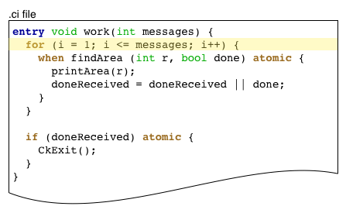
Counting with Coordination

Slide 35
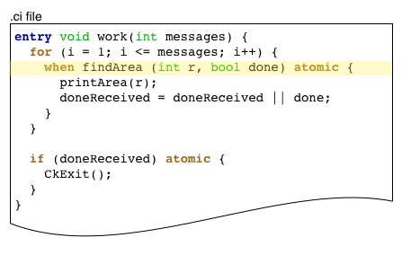
Counting with Coordination

Slide 36
Counting with Coordination

Slide 37
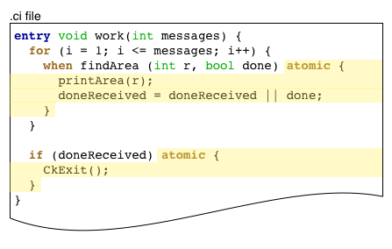
Counting with Coordination

Slide 38
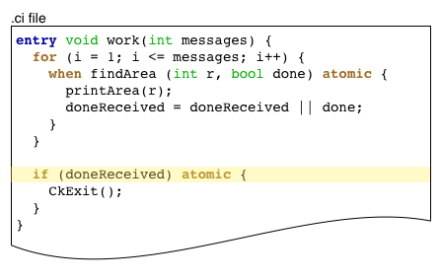
Counting with Coordination

Slide 39
Counting with Coordination

Slide 40
Charm++ Van der Waals Example

Slide 41
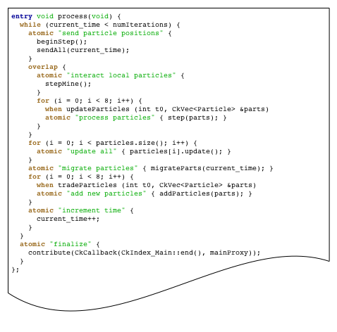
Cell’s Lifecycle

Slide 42
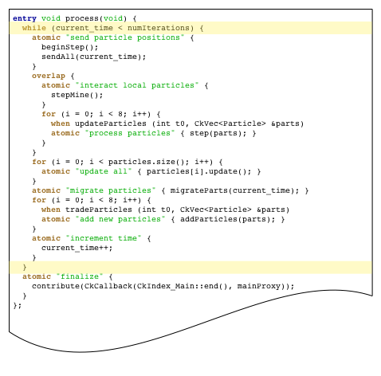
Cell’s Lifecycle

Slide 43
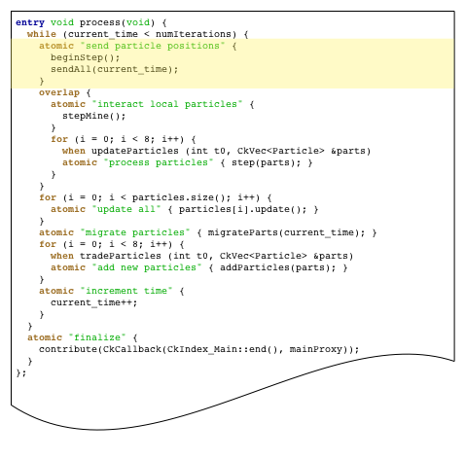
Cell’s Lifecycle

Slide 44
Sending the Particles

Slide 45
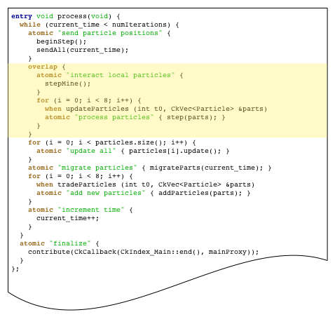
Cell’s Lifecycle

Slide 46
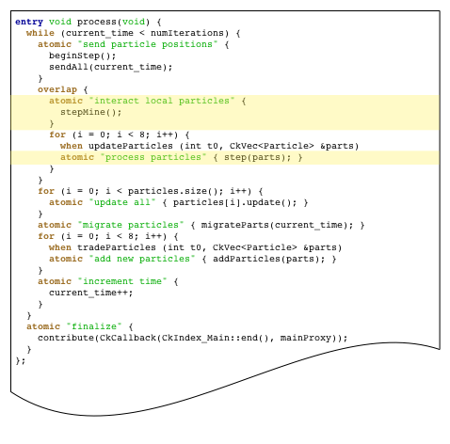
Cell’s Lifecycle

Slide 47
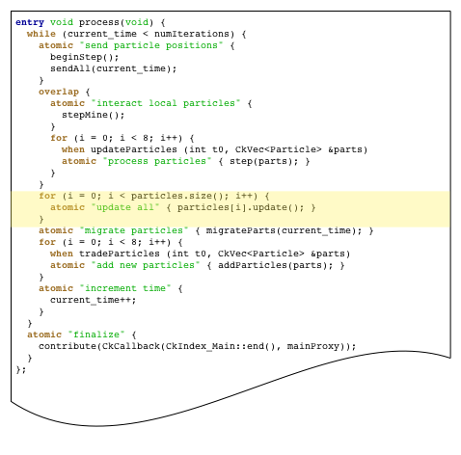
Cell’s Lifecycle

Slide 48
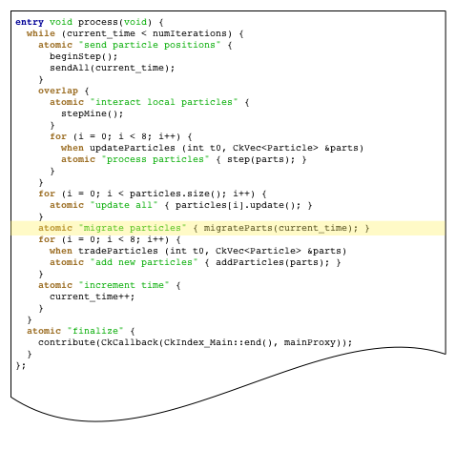
Cell’s Lifecycle

Slide 49
migrateParts() Method

Slide 50
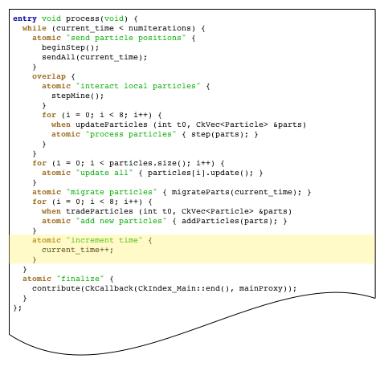
Cell’s Lifecycle

Slide 51
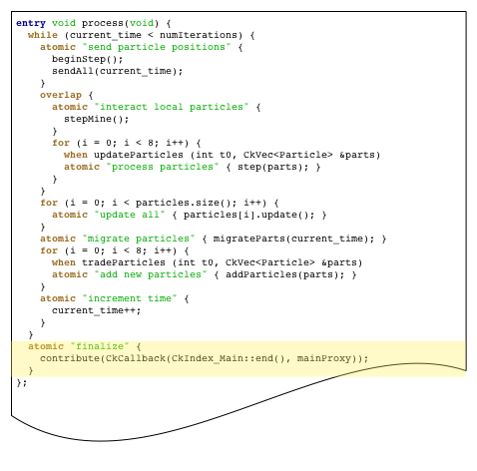
Cell’s Lifecycle

Slide 52
Cell’s Lifecycle

Slide 53
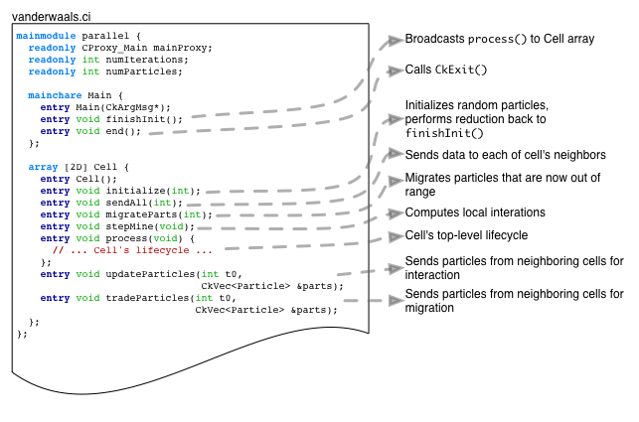
Charm++ Van der Waals Example

Slide 54
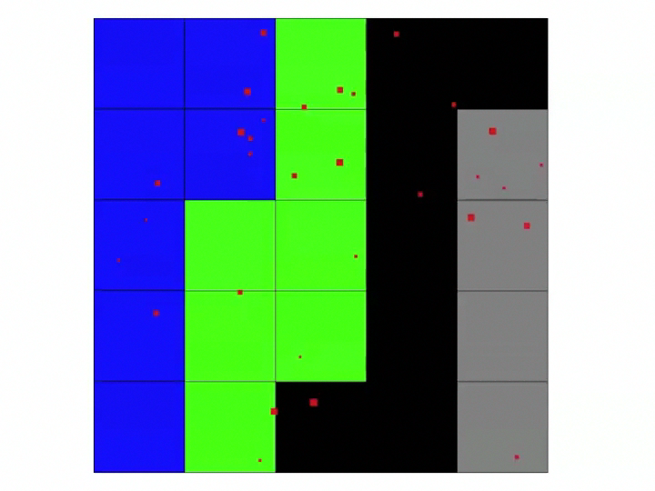

Slide 55
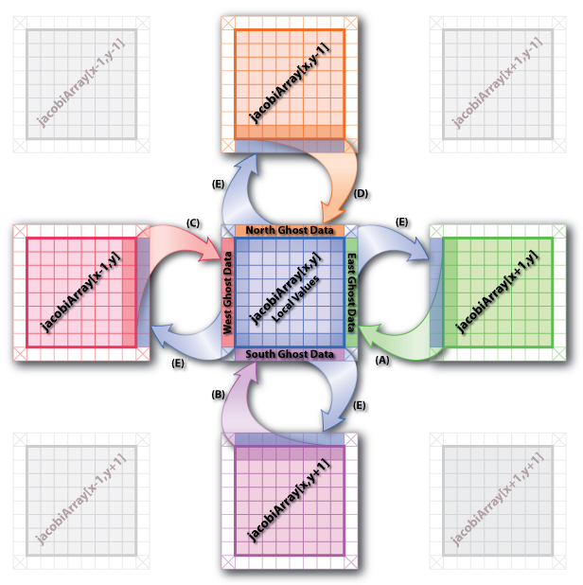
Jacobi Example

Slide 56
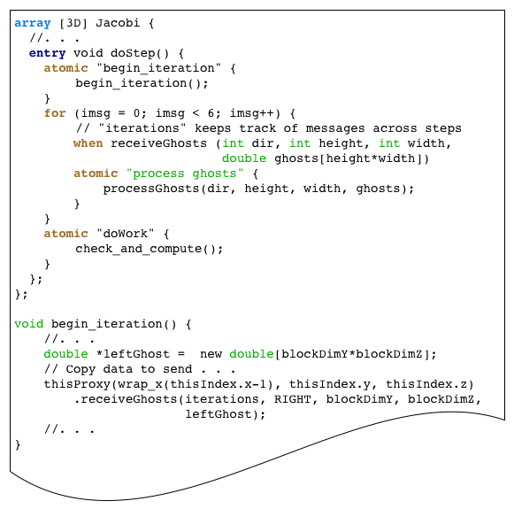
Incorrect Jacobi Code

Slide 57
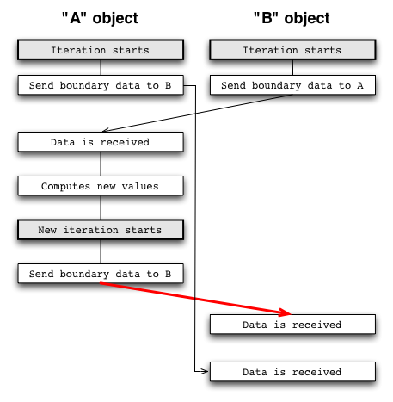
Incorrect Jacobi Code

Slide 58

Correct Jacobi Code

Slide 59

Simplified Jacobi Code

